Slide 1

Comparing Neighborhoods of New York & Toronto
Prashant Gorade

Slide 2
Introduction
In this Capstone project I am exploring the similarities between the New York City and the city of Toronto.
As Both cities are very diverse and are the financial capitals of their respective countries.
The objective of this study is to compare the neighbourhoods of the two cities and determine how similar or dissimilar they are from a tourist’s perspective.

Slide 3
Background
1
Both the cities are studied on the basis of
Food,
Shopping,
Nightlife,
Fun and
Coffee options available
2
A radius of 10 km is used from the centre of the cities.

Slide 4
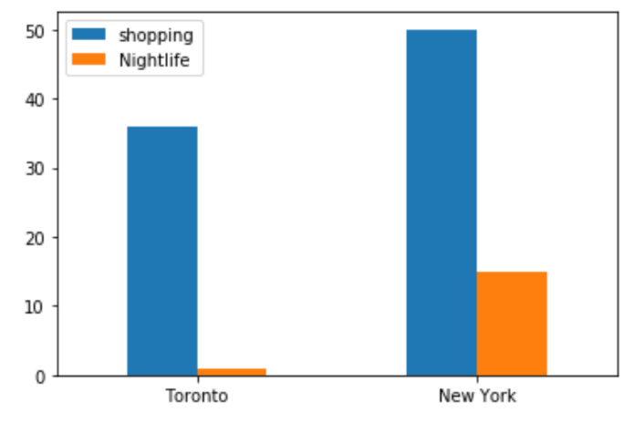
Nightlife and Shopping
Shopping is a key attraction for all tourists and also good source of revenue generation in cities like New York and Toronto
The bar chart here shows that the city of New York significantly exceeds the city of Toronto in terms of options for shopping
While when it comes to nightlife New York has roughly 4 times more options than the city of Toronto

Slide 5
Food, Coffee and Fun
From the bar chart shown here it is easily seen that both cities are similar in terms of options available for food, coffee and fun.

Slide 6
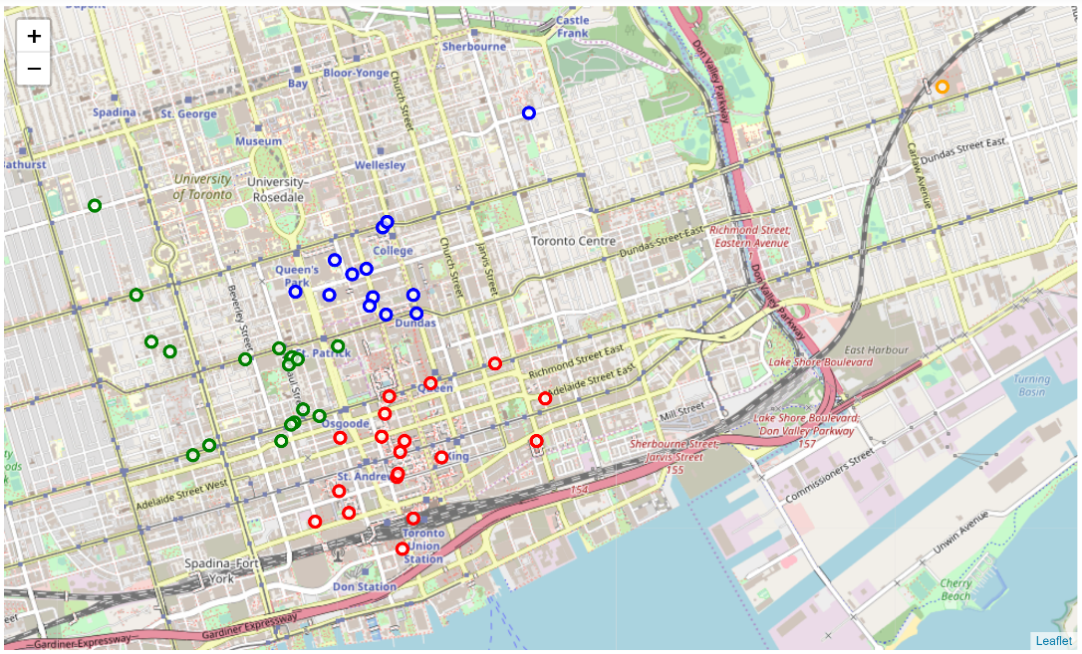
Clustering of Food options in Toronto
1
A sample cluster plot of the variety of food options available in a radius of 10 km is shown in the picture below.
2
Number of clusters = 4

Slide 7
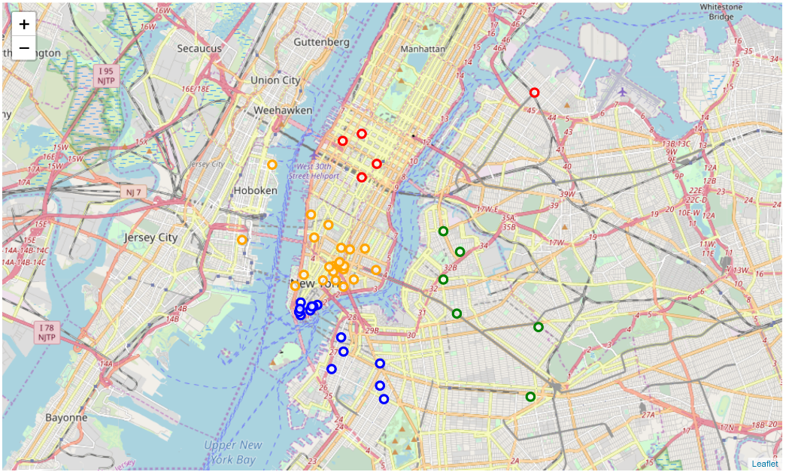
Clustering of Food options in New York
1
A sample cluster plot of the variety of food options available in a radius of 10 km is shown in the picture below.
2
Number of clusters = 4

Slide 8
Summary
1
The cluster plots show that both the cities have ample options for food, coffee and fun.
The city of New York significantly exceeds in numbers when it comes to Nightlife and shopping.
2
The fun options in both cities are closely spaced which means that the tourists wont miss visiting at least visiting a few of them. The summary of results has been shown below.
3

Slide 9
Conclusion
The neighbourhoods of New York and Toronto have been compared in this study on the basis of Food, Shopping, Coffee, Nightlife & Fun. A circular region of a radius of 10 km has been considered from the city centres for the study.
1
The city of New York is seen to have higher numbers of Nightlife and shopping options compared to that of the city of Toronto. This study will also be helpful for new start-ups who plan to start businesses in these areas. Both cities have almost equal or comparable number of options when it comes to food, coffee and fun related activities.
2
Notes:
In Slide Show mode, select the arrows to visit links.

